Slide 1


Image Captioning
MLA Training Summer 2022 Final Project

Slide 2

Problem statement
Image Captioning is the task of describing the content of an image in words. This task lies at the intersection of computer vision and natural language processing. Input image is encoded into an intermediate representation of the information in the image, and then decoded into a descriptive text sequence.

Slide 3
Applications on Image Captioning
Generate text from images. Use the information directly from any image in a textual format automatically.
Help visually impaired people. Lots of applications can be developed in that space.
Social Media. Platforms like Facebook can infer directly from the image, where you are (beach, cafe etc).

Slide 4

Datasets
We initially wanted to use the flickr30k dataset. This dataset presents Flickr30k Entities, which augments the 158k captions from Flickr30k with 244k coreference chains, linking mentions of the same entities across different captions for the same image, and associating them with 276k manually annotated bounding boxes. But due to its huge memory requirements, We ended up working on the flickr8k dataset in parallel with some progress in flickr30k dataset

Slide 5
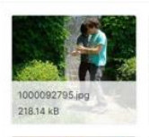
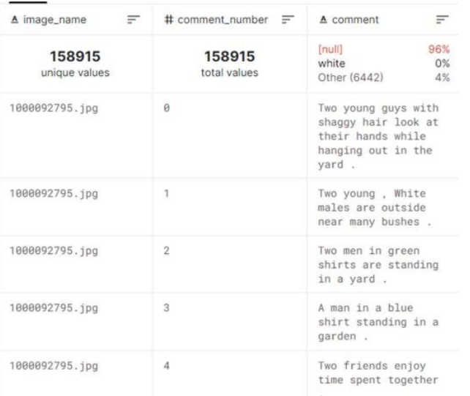

Slide 6

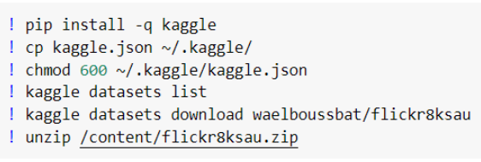
Loading the data using flickr8k dataset
We used Kaggle’s API tokens to connect google colab to Kaggle
The images and captions paths were as follows:

Slide 7
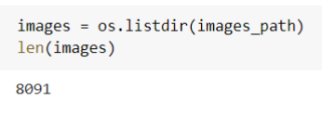
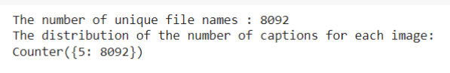
Data Description
The dataset size consists of 8091 images and each image has 5 captions describing it. The captions text file has the filename, next to it (#), then the index of the caption between 0 and 4 (5 captions) then a space tab and the caption itself, that’s how we were able to separate the filename, index and caption.

Slide 8
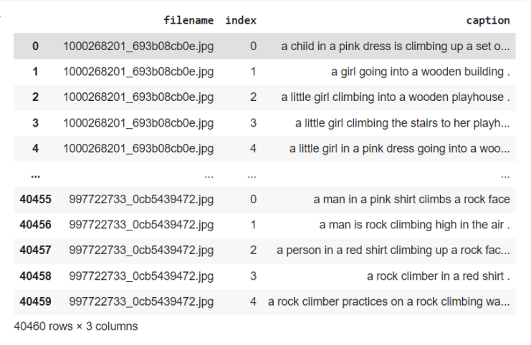
Data Visualization
The captions after being separated from the filename and index:

Slide 9
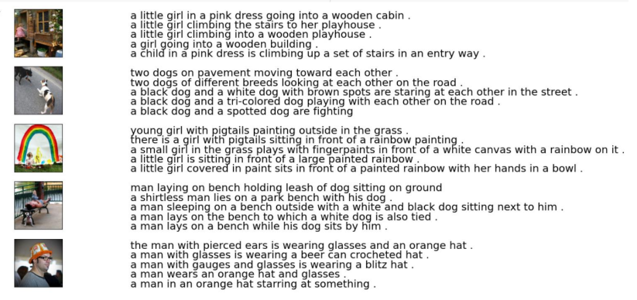
The images with their 5 corresponding captions:

Slide 10
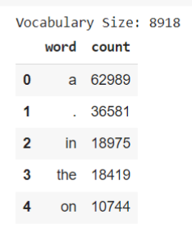
The most and least common words: We first made a data frame of all the words in all the captions, counted how many times each one of them is used and sorted the values.

Slide 11
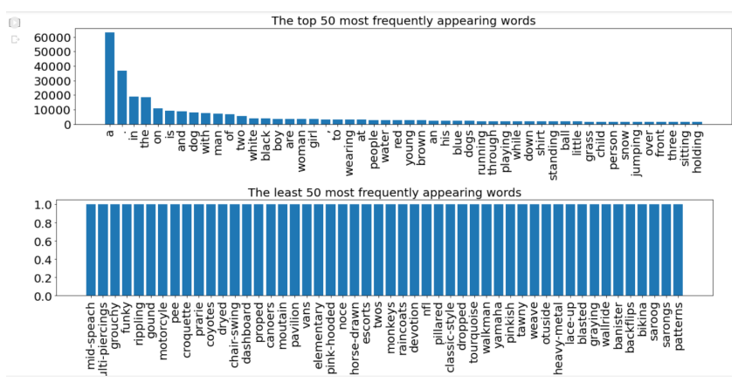
We then plotted the first and last 50 values in the data frame to represent the most and least common words, respectively.

Slide 12
Data Cleaning
Data cleaning has an important role in getting good accuracies in NLP (natural language processing) projects, as things like punctuations or digits affect the results of any text processing approach, especially what depends on the occurrence frequencies of words and phrases.

Slide 13
The encoder reads the input sequence to construct an embedding representation of the sequence. Terminating the input in an end-of-sequence token signals to the encoder that when it receives that input, the output needs to be the finalized embedding.
The decoder will progress by taking the tokens it emits as inputs, so before it has emitted anything it needs a token of some kind to start with, which is the start-of-sequence token.

Slide 14
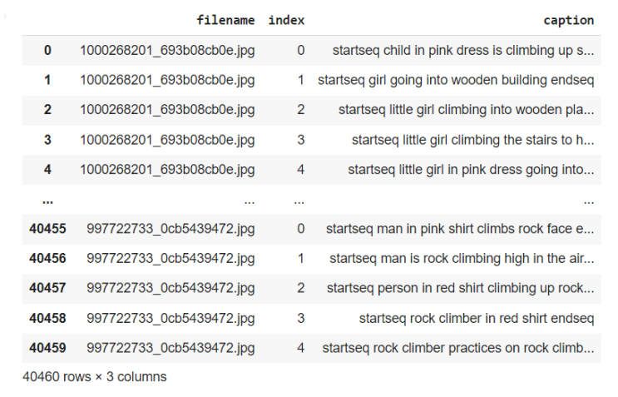
Tokenization is used in natural language processing to split paragraphs and sentences into smaller units that can be more easily assigned meaning. Our tokenizer is used to convert a set of training data, the captions, into a dictionary where each unique word gets a different ID.

Slide 15
Feature Extraction using ResNet
What is feature extraction?
Feature Extraction reduce the number of features by creating new features from the existing ones and then discarding the original features. These new reduced set of features summarize most of the information contained in the original set of features.
We need to do this because there may be some parts in the image that won’t affect the caption generated for it, like watermarks. Our feature extractor needs an image 224x224x3 size. The model uses ResNet50 pretrained on ImageNet dataset. Another dense layer is added and converted to get a vector of length 2048

Slide 16
Resnet 50
ResNet-50 is a convolutional neural network that is 50 layers deep. A pretrained version of the network trained on more than a million images from the ImageNet database can be loaded. The pretrained network can classify images into 1000 object categories. The network has learned rich feature representations for a wide range of images. The network has an image input size of 224-by-224.
Resnet 50 Architecture
ResNet50 is a variant of ResNet model which has 48 Convolution layers with 1 MaxPool & 1 Average Pool layer. It has 3.8 x 10^9 Floating points operations.

Slide 17
Why did we use Resnet 50 ?
Networks with large number of layers can be trained easily without increasing the training error percentage. ResNets help in tackling the vanishing gradient problem using identity mapping. ResNets are relatively faster than other pre-trained CNN transfer models and have relatively a smaller number of parameters than other pre-trained CNN transfer models

Slide 18
Train/Test Split
 | 80% | 20%
 | Training Data | Testing Data
We used 10% of the training data for validation while building the models.

Slide 19
Data Pre-processing
We need padding as sentences can be different in length, we need to have the inputs with the same size, this is where the padding is necessary. So, identifier sequences are padded at the end with null tokens to ensure that they are all the of same length.

Slide 20
LSTM Model
The Encoder-Decoder architecture is utilized for settings where a varied-length input sequence is mapped to the varied-length output sequence. Core idea is to use CNN as encoder and a normal RNN (LSTM) as decoder. We tried 4 different LSTM models, 3 models where there was a great deal of overfitting, so we tried to overcome it using batch normalization layers, dropout layers and l2 regularization. However, due to the lack of enough data, we couldn’t pass the accuracy over 50% for train accuracy and around 30% for validation accuracy. We believe that this accuracy can be improved by using the same model on larger datasets.

Slide 21
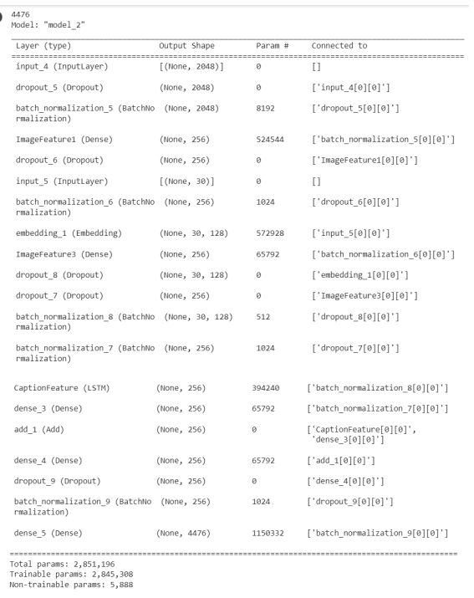
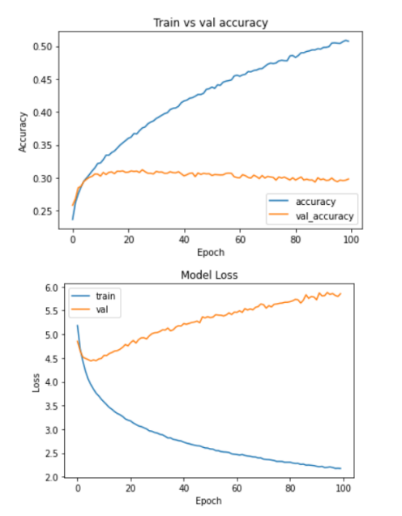

Slide 22
Testing process
We first made a method that predicts the caption of the images in the test set through our trained model. Then we plotted some of the test set images with their predicted captions.

Slide 23
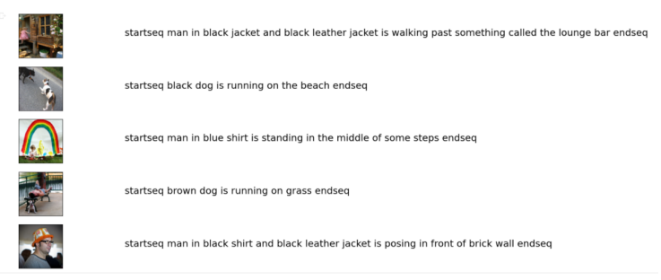

Slide 24
To be able to test the accuracy in a professional way, we used BLEU accuracy. BLEU (bilingual evaluation understudy) is an algorithm for evaluating the quality of text which has been machine-translated, we provide it with the true caption and the predicted caption of the test image to be able to calculate it. Then, we divide the predicted captions into two sets, good captions having bleu probability of 0.5 or more and bad captions having bleu probability of 0.2 or less, finally we plot both sets.

Slide 25
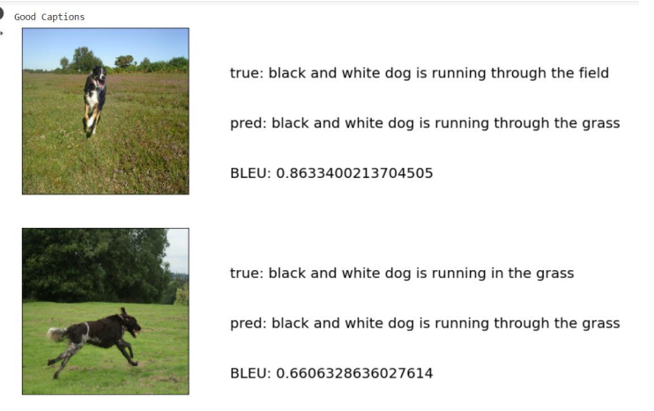
Good Captions

Slide 26
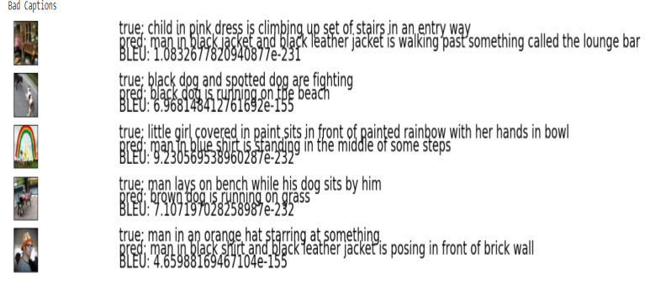
Bad Captions

Slide 27
Work using the flickr30 dataset
As mentioned before, we tried working with the flickr30k dataset, but we faced a lot of obstacles with the runtime and memory, so we ended up using only half the dataset.
The only differences between the flickr8k and flickr30k datasets are the format in which the captions are written, and the train/test split we applied.

Slide 28
Train/Test Split
 | 70% | 30%
 | Training Data | Testing Data
We used 5% of the training set for validation during our training process

Slide 29
Captions Format
Here, the captions are recorded as filename (space) comment number (tab space) the caption. So, in order to break this down we wrote the following method.
LSTM Model
We used the same model as flickr8k dataset, but here we noticed that the overfitting was less than the flickr8k dataset. Each epoch took around 330 seconds to run which made the runtime to stop at 91/100 epochs, reaching a train accuracy of around 30% and validation accuracy of around 25%.

Slide 30

Links
Link for the flickr8k dataset: https://www.kaggle.com/datasets/waelboussbat/flickr8ksau
Link for the flickr30k dataset: https://www.kaggle.com/datasets/hsankesara/flickr-imagedataset
Link for image captioning on flickr8k notebook: https://colab.research.google.com/drive/1W8KdNUa77cyEkD0u6l9O8RhjEnFbQd_Z?usp=sh aring
Link for image captioning on flickr30k notebook: https://colab.research.google.com/drive/1XxNaKIe_cqIWg0e_1wl0owAc5W2Xnbf6?usp=sha ring

Slide 31
References
• https://www.geeksforgeeks.org/image-caption-generator-using-deep-learning-on-flickr8kdataset/
•https://www.researchgate.net/publication/329037107_Image_Captioning_Based_on_Deep _Neural_Networks
• https://towardsdatascience.com/image-captioning-in-deep-learning-9cd23fb4d8d2
• https://machinelearningprojects.net/image-captioning/

Slide 32

Supervised by:
Dr. Marwan Turki
Eng. Adel Atef
Team Norm:
Mennatallah Moustafa 6234
Rawan Hindawy 6491
Nouran Hisham 6532

Slide 33

THANKS!

